Slide 1
PART - 1

Slide 2
Api’s : UNRavel

Slide 3
AGENDA
Introduction​ to API’s
Concepts and Practical
API Testing
​Summary​

Slide 4
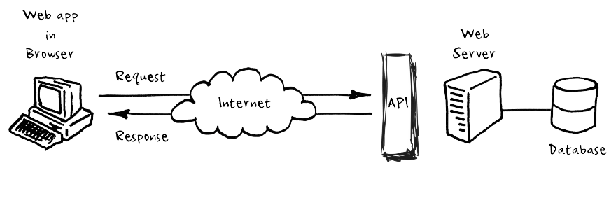
Application Programming Interfaces (APIs)
APIs are end-to-end software interfaces in simpler terms, a set of instructions for communication between client and server.
APIs provide a secure and consistent way for applications to work with each other and deliver the information.

Slide 5
Concepts & Practical

Slide 6
Components of API
Method
endpoint
body
Status co.
parameter
GET, POST are methods for data retrieval and updating.
Direct connection to resource aka URI.
Response generated by request. Data is generally in JSON & XML.
A code number in the response header that indicates the classification of the response.
Parameters are the options passed along with the request.

Slide 7
Types of API Request
GET
POST
PUT
DELETE
PATCH
Request a resource from the database.
Add something to the database.
Update a resource in the database.
Delete a resource from the database.
Partially delete a resource.

Slide 8
Types of Status Codes
1XX
2XX
3XX
4XX
5XX
The server has acknowledged the request.
The server has completed the request.
The server has redirected the request.
The API request failed due to client error.
The API request failed due to server error.

Slide 9
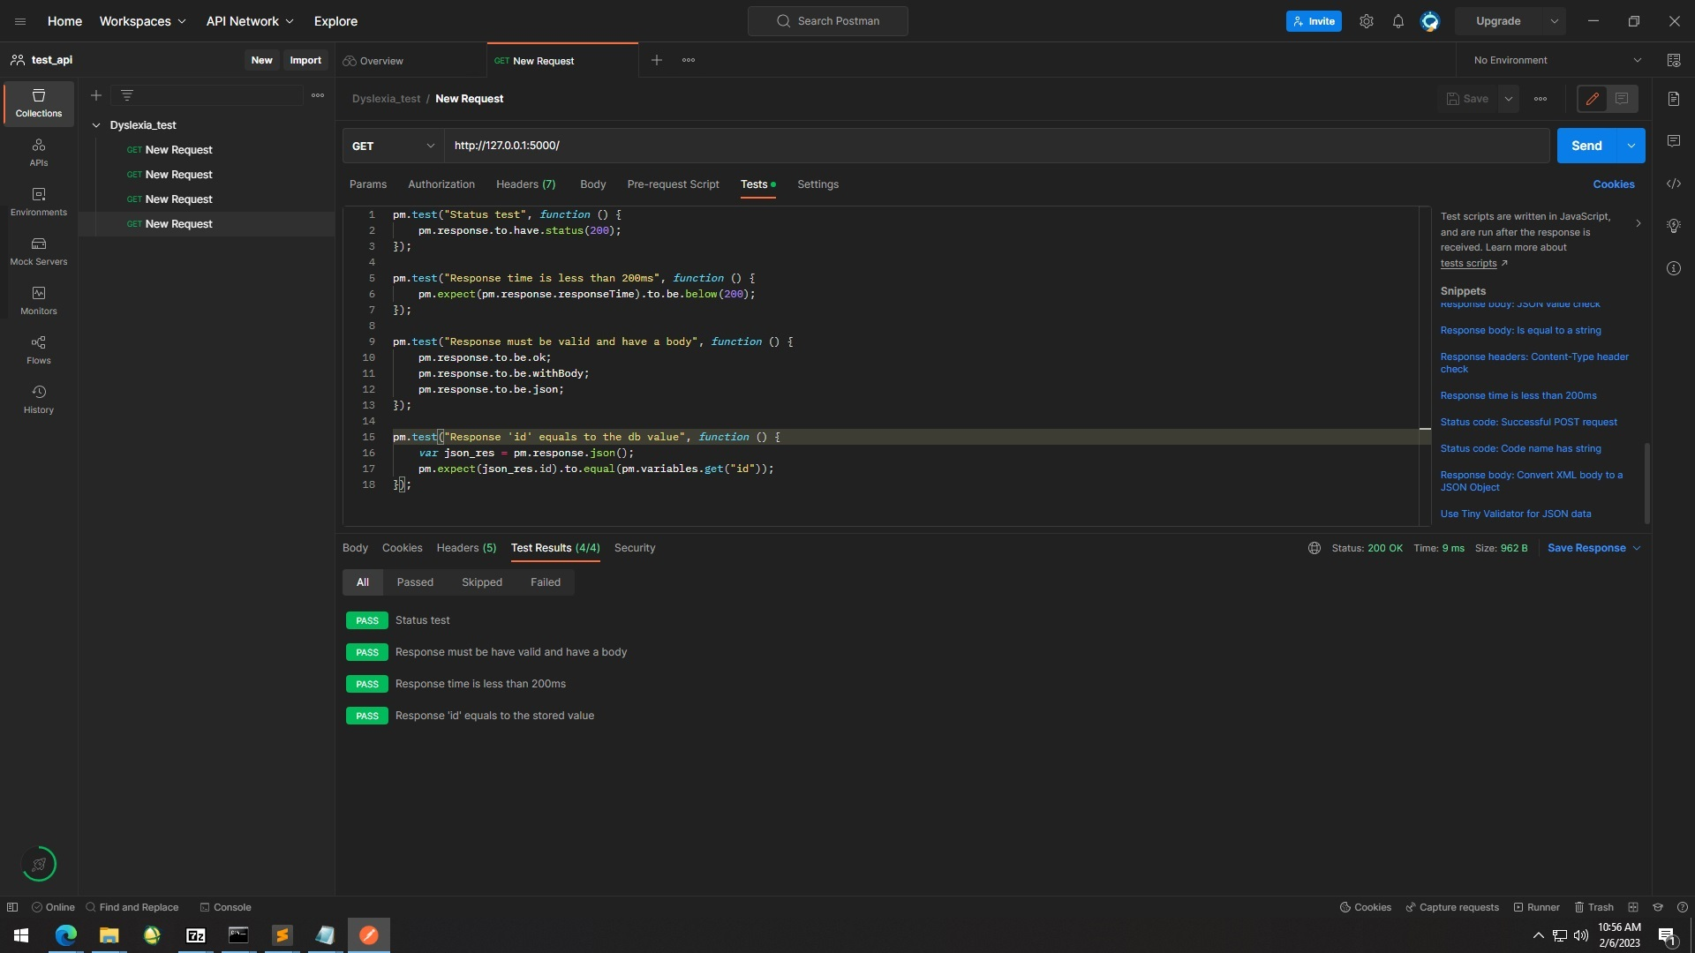

Slide 10
API implementation
App Development Using HTML, CSS, JS And Weather API
Deploy App using GitHub Pages
Code Link : https://tinyurl.com/yckkxyz9
App Link : https://harshaditya23.github.io/weatherapi/

Slide 11



API TESTING
VALIDATION
Integration
Security
API testing ensures that the API’s are working as expected and according to the specifications.
Ensures that the integration is seamless and error-free.
APIs are often exposed to the public and can be vulnerable to attacks. Testing helps to identify vulnerabilities and ensures that they secured.

Slide 12
SUMMARY
API connects two devices or programs in order to facilitate the exchange of information between them. APIs are constantly working in the background to give you richer digital experiences. Thanks to APIs, we are able to purchase our movie ticket online or finding a great deal for our travel plan.
API security is a key component of modern web application security. API security can help you to have an end-to-end secure workflow with a secure environment to work in.

Slide 13
PART - 2

Slide 14

API TESTING Keploy

Slide 15
AGENDA
About Keploy
Working of Keploy
About : API Fellowship
Uniqueness of Keploy
​Summary​

Slide 16
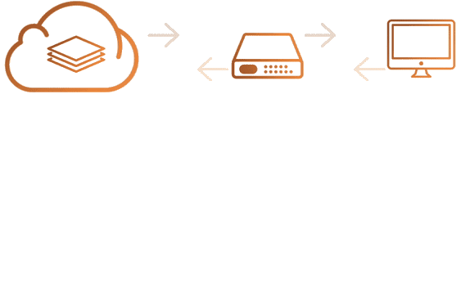
About Keploy
Keploy is an open-source, no-code API testing platform that generates unit test cases and data mocks from API calls.
Dependency mocks are automatically generated with the recorded requests and responses.

Slide 17
Working of Keploy

Slide 18
export KEPLOY_MODE=" "
Keploy adds middleware to your application. Capturing and replaying all application network interactions from any source.
Step 1 : Record Unique Network Interactions as Test Case.
export KEPLOY_MODE="record"
Step 2 : Replay Test-Cases.
export KEPLOY_MODE="test"

Slide 19
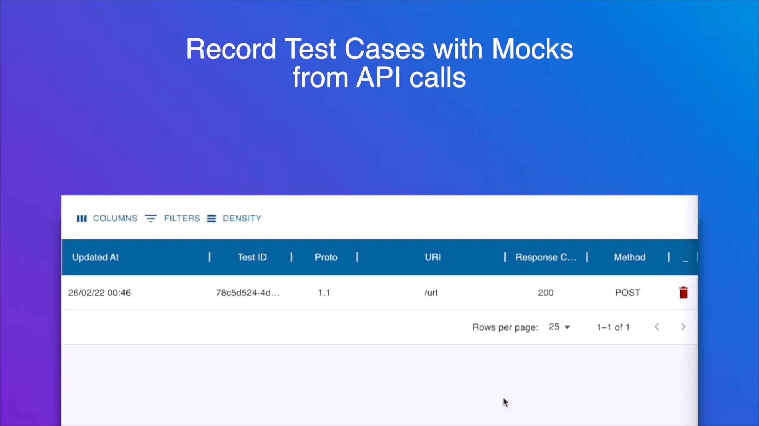

Slide 20
Uniqueness of Keploy
Convert API calls from anywhere to Test-Case
Automatically
mock Mutations
Accurate Noise Detection
Native interoperability
Easy Integration Framework for new Libraries

Slide 21
Api fELLOWSHIP
Keploy organizes fellowship program for students and individuals. Spreads awareness about the APIs, unit testing, and how Keploy automates the testing process.
For more details and my overall experience in 2nd cohort of fellowship : https://tinyurl.com/3zwt33wn

Slide 22
TO DO -
Visit Keploy GitHub Repo and STAR IT.
Join Keploy on Slack.
Check Keploy Documentation.

Slide 23
THANK YOU
Harshaditya Gaur
gaurharsh24@gmail.com

